Slide 1
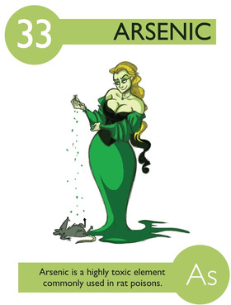
Arsenic
Lila Baker
Zack Rushing

Slide 2
Introduction
Occurs naturally in Earth’s crust
Combines with other elements -> Inorgainic
Higher than average exposure from:
  Workplaces, hazardous waste sites
  Naturally occurring from soil, rocks, water

Slide 3
Arsenic & Humans
Primary exposure is from ingestion and inhalation but dermal absorption also occurs
Undergoes biomethylation in liver
70% of arsenic is excreted (mostly in urine)

Slide 4
Global Issue
Known human carcinogen w/ non-cancer effects
>200 million chronically exposed (WHO)
  3% of world’s population
Worldwide problem

Slide 5
Chronic Exposure
Can lead to:
  Dermatitis
  Mild pigmentation of skin & cancer
  Vasospasticity
  Gross pigmentation w/ hyperkeratization
  Wart formation
  Decreased NCV
  Lung Distress & Cancer
  Bladder and kidney cancer
  Weakness
  Anemia
  “Burning” eyes
  Solid swelling of legs
  Liver fibrosis
  Gangrene of toes
  Neuropathy
  Low birth weight
Notes:
Citation: Arsenic. (2012, March 21). Retrieved from http://www.osha.gov/SLTC/arsenic/

Slide 6
Arsenic in Water
Arsenic containing rocks
Prevalent in some ores more than others
Natural contamination process
  Humans can influence it too

Slide 7
Bangladesh
WHO calls it “The largest mass poisoning of a population in history.”
35-77 million people chronically exposed
Contamination wasn’t realized until the late 1990s

Slide 8
Contamination Levels
The US EPA Regulation for Arsenic in drinking water is 10 ppb or 0.010 mg/L – same as WHO (EPA, 2012)
Up to 11% of US water sources are currently over the contamination limit (EPA, 2012)
  What is being done to reduce Arsenic contamination?
  How is it removed?
    Adsorption media, ion exchange, coagulation/filtration, oxidation/filtration, and point-of-use or point-of-entry treatment using activated alumina or reverse osmosis. (EPA, 2012)
Notes:
In 1974, Congress passed the Safe Drinking Water Act. This law requires EPA to determine the level of contaminants in drinking water at which no adverse health effects are likely to occur. These non-enforceable health goals, based solely on possible health risks and exposure over a lifetime with an adequate margin of safety, are called maximum contaminant level goals (MCLG). Contaminants are any physical, chemical, biological or radiological substances or matter in water.
The MCLG for arsenic is zero. EPA has set this level of protection based on the best available science to prevent potential health problems. Based on the MCLG, EPA has set an enforceable regulation for arsenic, called a maximum contaminant level (MCL), at 0.010 mg/L or 10 ppb. MCLs are set as close to the health goals as possible, considering cost, benefits and the ability of public water systems to detect and remove contaminants using suitable treatment technologies.
The Arsenic and Clarifications to Compliance and New Source Contaminants Monitoring Final Rule, the regulation for arsenic, became effective in 2002. The Safe Drinking Water Act requires EPA to periodically review and revise contaminants, if appropriate, based on new scientific data. The regulation for arsenic will be included in a future review cycle.
In accordance with the Arsenic Rule, systems must demonstrate compliance with the revised arsenic maximum contaminant level (MCL) (10 ppb) at each entry point to the distribution system. Systems utilizing multiple sources will need to consider a mitigation strategy for each entry point to the distribution system that exceeds the revised MCL.
A system will need to optimize existing treatment or install new treatment if it has high arsenic sources and cannot achieve compliance through a non treatment options such as blending, seasonal use of sources, or development of an alternative source. The system should first determine whether any of its existing treatment technology is capable of removing arsenic even though it may not be doing so currently.
Treatment may be accomplished at the wellhead, as a centralized treatment system (water pumped from several sources to a centralized location for treatment before entering the distribution system). Also, treatment located at the Point-of-Use (POU) or Point-of-Entry (POE) within a building or entering a building, respectively, may be appropriate in some situations.
Click on a link below to find information on each compliance option. These descriptions provide a first-look introduction to arsenic treatment technologies. For additional information, including technical design manuals, click on the links at the end of each section.

Slide 9
Arsenic Metabolism
Main Form of Metabolism:
  Methylation in Liver and excreted through kidneys
Biological half life of Arsenic:
1 = 1 + 1 + 1 + 1 + 1 .
t_{1/2} , eff t_{1/2} , hep t_{1/2} , renal t_{1/2} , pulm t_{1/2} , fecal t_{1/2} , persp
Pulmonary, fecal, and perspiration are negligible in the calculations.
Overall, half life is 10 hours.
Notes:
The primary method of metabolizing arsenic in humans is methylation.
Although once considered the main mechanism of detoxification, studies have implied the existence of other more important arsenic detoxification mechanisms in mammals.
The main route of arsenic excretion is in the urine.
Humans excrete a combination of inorganic arsenic and its mono and dimethylated metabolites in the urine.
Arsenic from drinking water is excreted within 2 days once ingestion is stopped, but may still show in trace amounts in urine (not blood) for up to 2 weeks

Slide 10
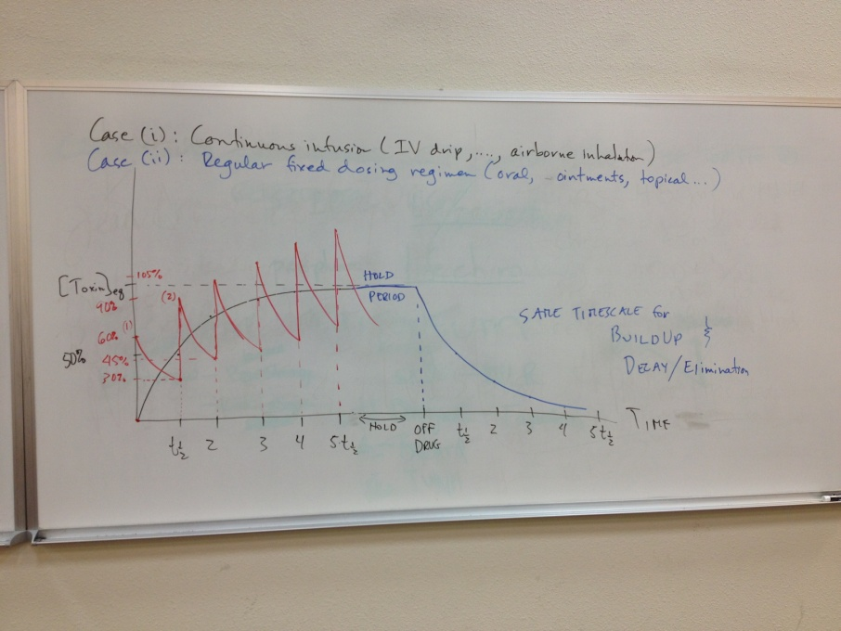
Dose Response
To stay below NOAEL:
  <.05 mg/L in drinking water
  <.02 mg/L for adults
Keeps levels below Toxicity line shown on graph.
(Ponteus, FW, et al., 1994)

Slide 11
Patient Communication
So, how does this apply to Chiropractors in Practice?
  Strange dermatological symptoms?
  GIGU problems?
  Talk to your patients about the possibility of Arsenic poisoning
Get the word out: (EPA, 2012)
  Counter articles
  Chalk/white board info
  Local Contact Information
Notes:
EPA strongly encourages people to learn more about their drinking water, and to support local efforts to protect and upgrade the supply of safe drinking water. Your water bill or telephone book’s government listings are a good starting point for local information.
Contact your water utility. EPA requires all community water systems to prepare and deliver an annual consumer confidence report (CCR) (sometimes called a water quality report) for their customers by July 1 of each year. If your water provider is not a community water system, or if you have a private water supply, request a copy from a nearby community water system.

Slide 12
Bibliography
OSHA. (2012, March 21). Arsenic. Retrieved on May 7, 2013 from http://www.osha.gov/SLTC/arsenic/
ATSDR. (2009, March). Case Studies in Environmental Medicine: Arsenic Toxicity. Retrieved on May 8, 2013 from http://www.atsdr.cdc.gov/csem/arsenic/docs/arsenic.pdf
EPA (2012). Basic Information about Arsenic in Drinking Water. Retrieved on May 7, 2013 from http://water.epa.gov/drink/contaminants/basicinformation/arsenic.cfm
Naujokas, M., et al. (2013). The broad scope of health effects from chronic arsenic exposure: Update on a worldwide public health problem. Environmental Health Perspectives, 121(3), 295-302. doi: PMC3621177
Chaudhuri, S., et al (2012). Theraputic profile of t11ts vs. t11ts miadmasa: A hunt for a more effective therapeutic regimen for arsenic exposure. Asian Pacific J Cancer Prev,13(6), 2943-2948. Retrieved from http://dx.doi.org/10.7314/APJCP.2012.13.6.2943
Pontius, FW et al. (1994) Health Implications of Arsenic in Drinking Water. American Water Works Association Journal. September, 1994. pp 52-63.
Some, I., et al (2012). Arsenic levels in tube-wells water, food, resident's urine and the prevalence of skin lesions in yatenga province, burkina faso. Interdisciplinary Toxicology, 5(1), 38-41. doi: 10.2478/v10102-012-0007-4
Syed, E., et al. (2012). Quality of life and mental health status of arsenic-affected patients in a bangladeshi population. J Health Popul Nutr,30(3), 262-269.

